Slide 2

Keeping data safe is very important for many reasons. There can be very confidential details that people want to keep safe.
Data can be corrupted or deleted either through accidental or through malicious act. There are many ways to keep data safe
Computer security refers to protecting computer hardware, software and information stored on computer from threats
Importance of computer security
•Computer users often exchange information or communicate over internet.
• This can infect a user's computer with virus or other types of malicious software.
• Computer security or safety is important for computer users to protect their computers from different threats

Slide 3
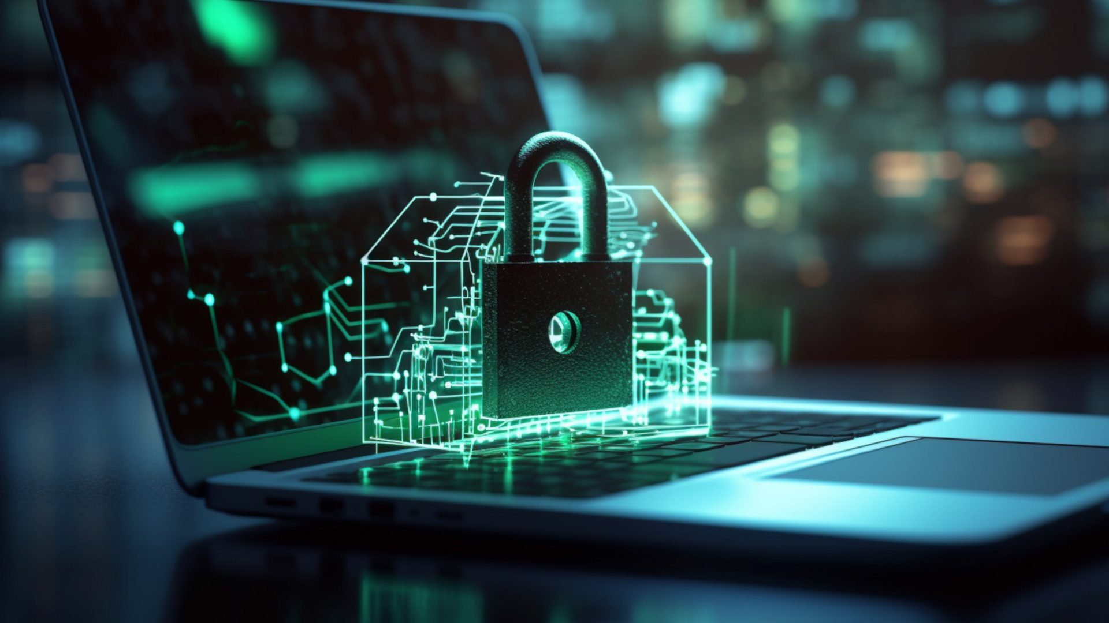
Cyber Crime
Cybercrime refers to any crime that is committed by means of computer and internet technology by having unlawful access to other computers.
Computer & internet have improved our lives but the same technology is also used by criminals to harm the society.
Cyber crime now include the activities that cross international borders and can be considered global epidemic.
The following are the commonly committed cyber crimes.
Computers have been involved in crimes such as fraud, kidnapping, murder and stealing money from banks
Criminals use internet to steal personnel information of other users and commit various types of cyber crime

Slide 4
Security and Data Integrity
Malware:
This is software used to gain access or damage a computer without the knowledge of the owner. There are various types of malware including spyware, keyloggers, true viruses, worms, or any type of malicious code that infiltrates a computer.
Disrupts operations.
Steals sensitive information.
Allows unauthorized access to system resources.
Slows computer or web browser speeds.
Creates problems connecting to networks.
Results in frequent freezing or crashing.
Install Anti-Virus & Firewall Software. Keep Software & Operating Systems Up-to-Date. Avoid Clicking On Pop-Ups

Slide 5
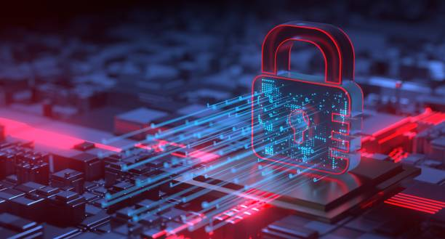
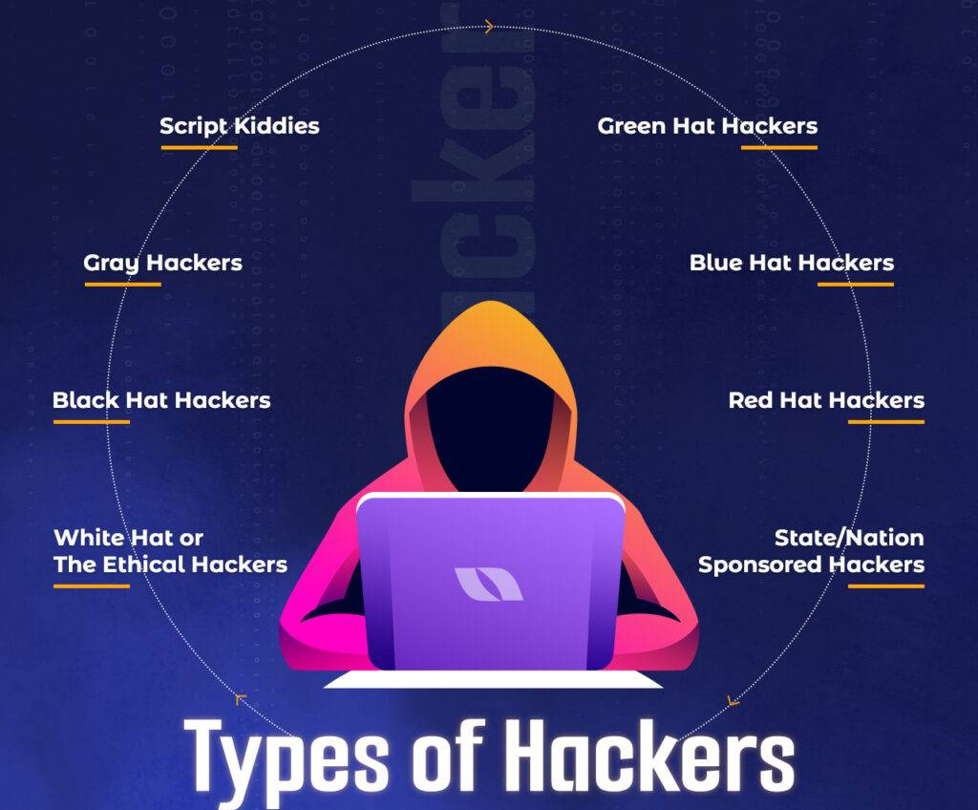
Hacking
Hacking is the act of gaining illegal access to a computer system. Hacking can lead to identity theft and gain of confidential data. Data can be deleted, changed and even corrupted. Hacking can be prevented by Firewalls, use of strong passwords and user ids and anti-hacking software. There are two types of hacking, White Hat and Black Hat. White hat is ethical hacking whereas Black hat is illegal hacking

Slide 6



Ethical Hacking
Ethical hacking, also known as white-hat hacking, is a type of hacking that involves testing computer systems for vulnerabilities and weaknesses in order to identify potential security risks. Ethical hackers are hired by organizations to help improve their security measures by identifying vulnerabilities that could be exploited by malicious hackers.
Illegal Hacking
Illegal hacking, also known as black-hat hacking, is a type of hacking that involves gaining unauthorized access to computer systems, stealing personal information, disrupting computer systems, or causing other types of harm. Illegal hackers may also use their skills to distribute malware, steal identities, or engage in other criminal activities.
Grey-Hat Hacking
There is also a type of hacking called grey-hat hacking, which falls somewhere in between ethical and illegal hacking. Grey-hat hackers may test computer systems without permission, but they do not have malicious intentions. Instead, they may use their skills to identify vulnerabilities and then contact the organization to inform them of the vulnerability.

Slide 7
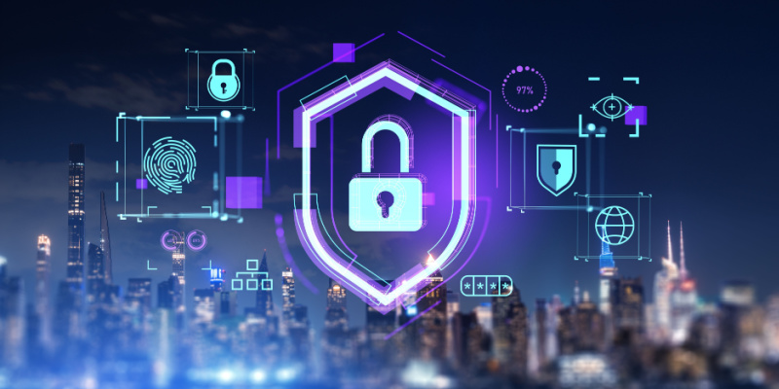
Viruses
Viruses are programs or a program code which can replicate itself with the intention of deleting or corrupting files, or cause the computer to malfunctions. It can delete files and data and it can corrupt them. It can also cause the device to crash and not respond. They can be prevented by anti virus software’s, and staying alert and aware of the emails you open and not using software’s from unknown resources.
Phishing
Phishing is run by a person or a creator that sends out a legitimate looking email. and as soon as the recipient clicks on the link, they are sent to a fake website. The creator of the email can access of personal data and this can lead to fraud or identity theft. This can be prevented by ISPs filters on emails and the user should be alert and aware when opening unknown attachments.

Slide 9
Cyber Crime  cybercrime refers to any crime that is committed by means of computer and internet technology by having unlawful access to other computers.  Computer & internet have improved our lives but the same technology is also used by criminals to harm the society. SAMINA KHAN, FAZAIA DEGREE COLLEGE RISALPUR
8. Cyber crime  Cyber crime now include the activities that cross international borders and can be considered global epidemic. SAMINA KHAN, FAZAIA DEGREE COLLEGE RISALPUR
9. Cyber crime  The following are the commonly committed cyber crimes.  Computers have been involved in crimes such as fraud, kidnapping, murder and stealing money from banks  Criminals use internet to steal personnel information of other users and commit various types of cyber crime

Slide 10
Keeping data safe is very important for many reasons. There can be very confidential details that people want to keep safe.
Data can be corrupted or deleted either through accidental or through malicious act. There are many ways to keep data safe.
Computer security refers to protecting computer hardware, software and information stored on computer from threats
Importance of computer security • Computer users often exchange information or communicate over internet. • This can infect a user's computer with virus or other types of malicious software. • Computer security or safety is important for computer users to protect their computers from different threats

